Slide 1
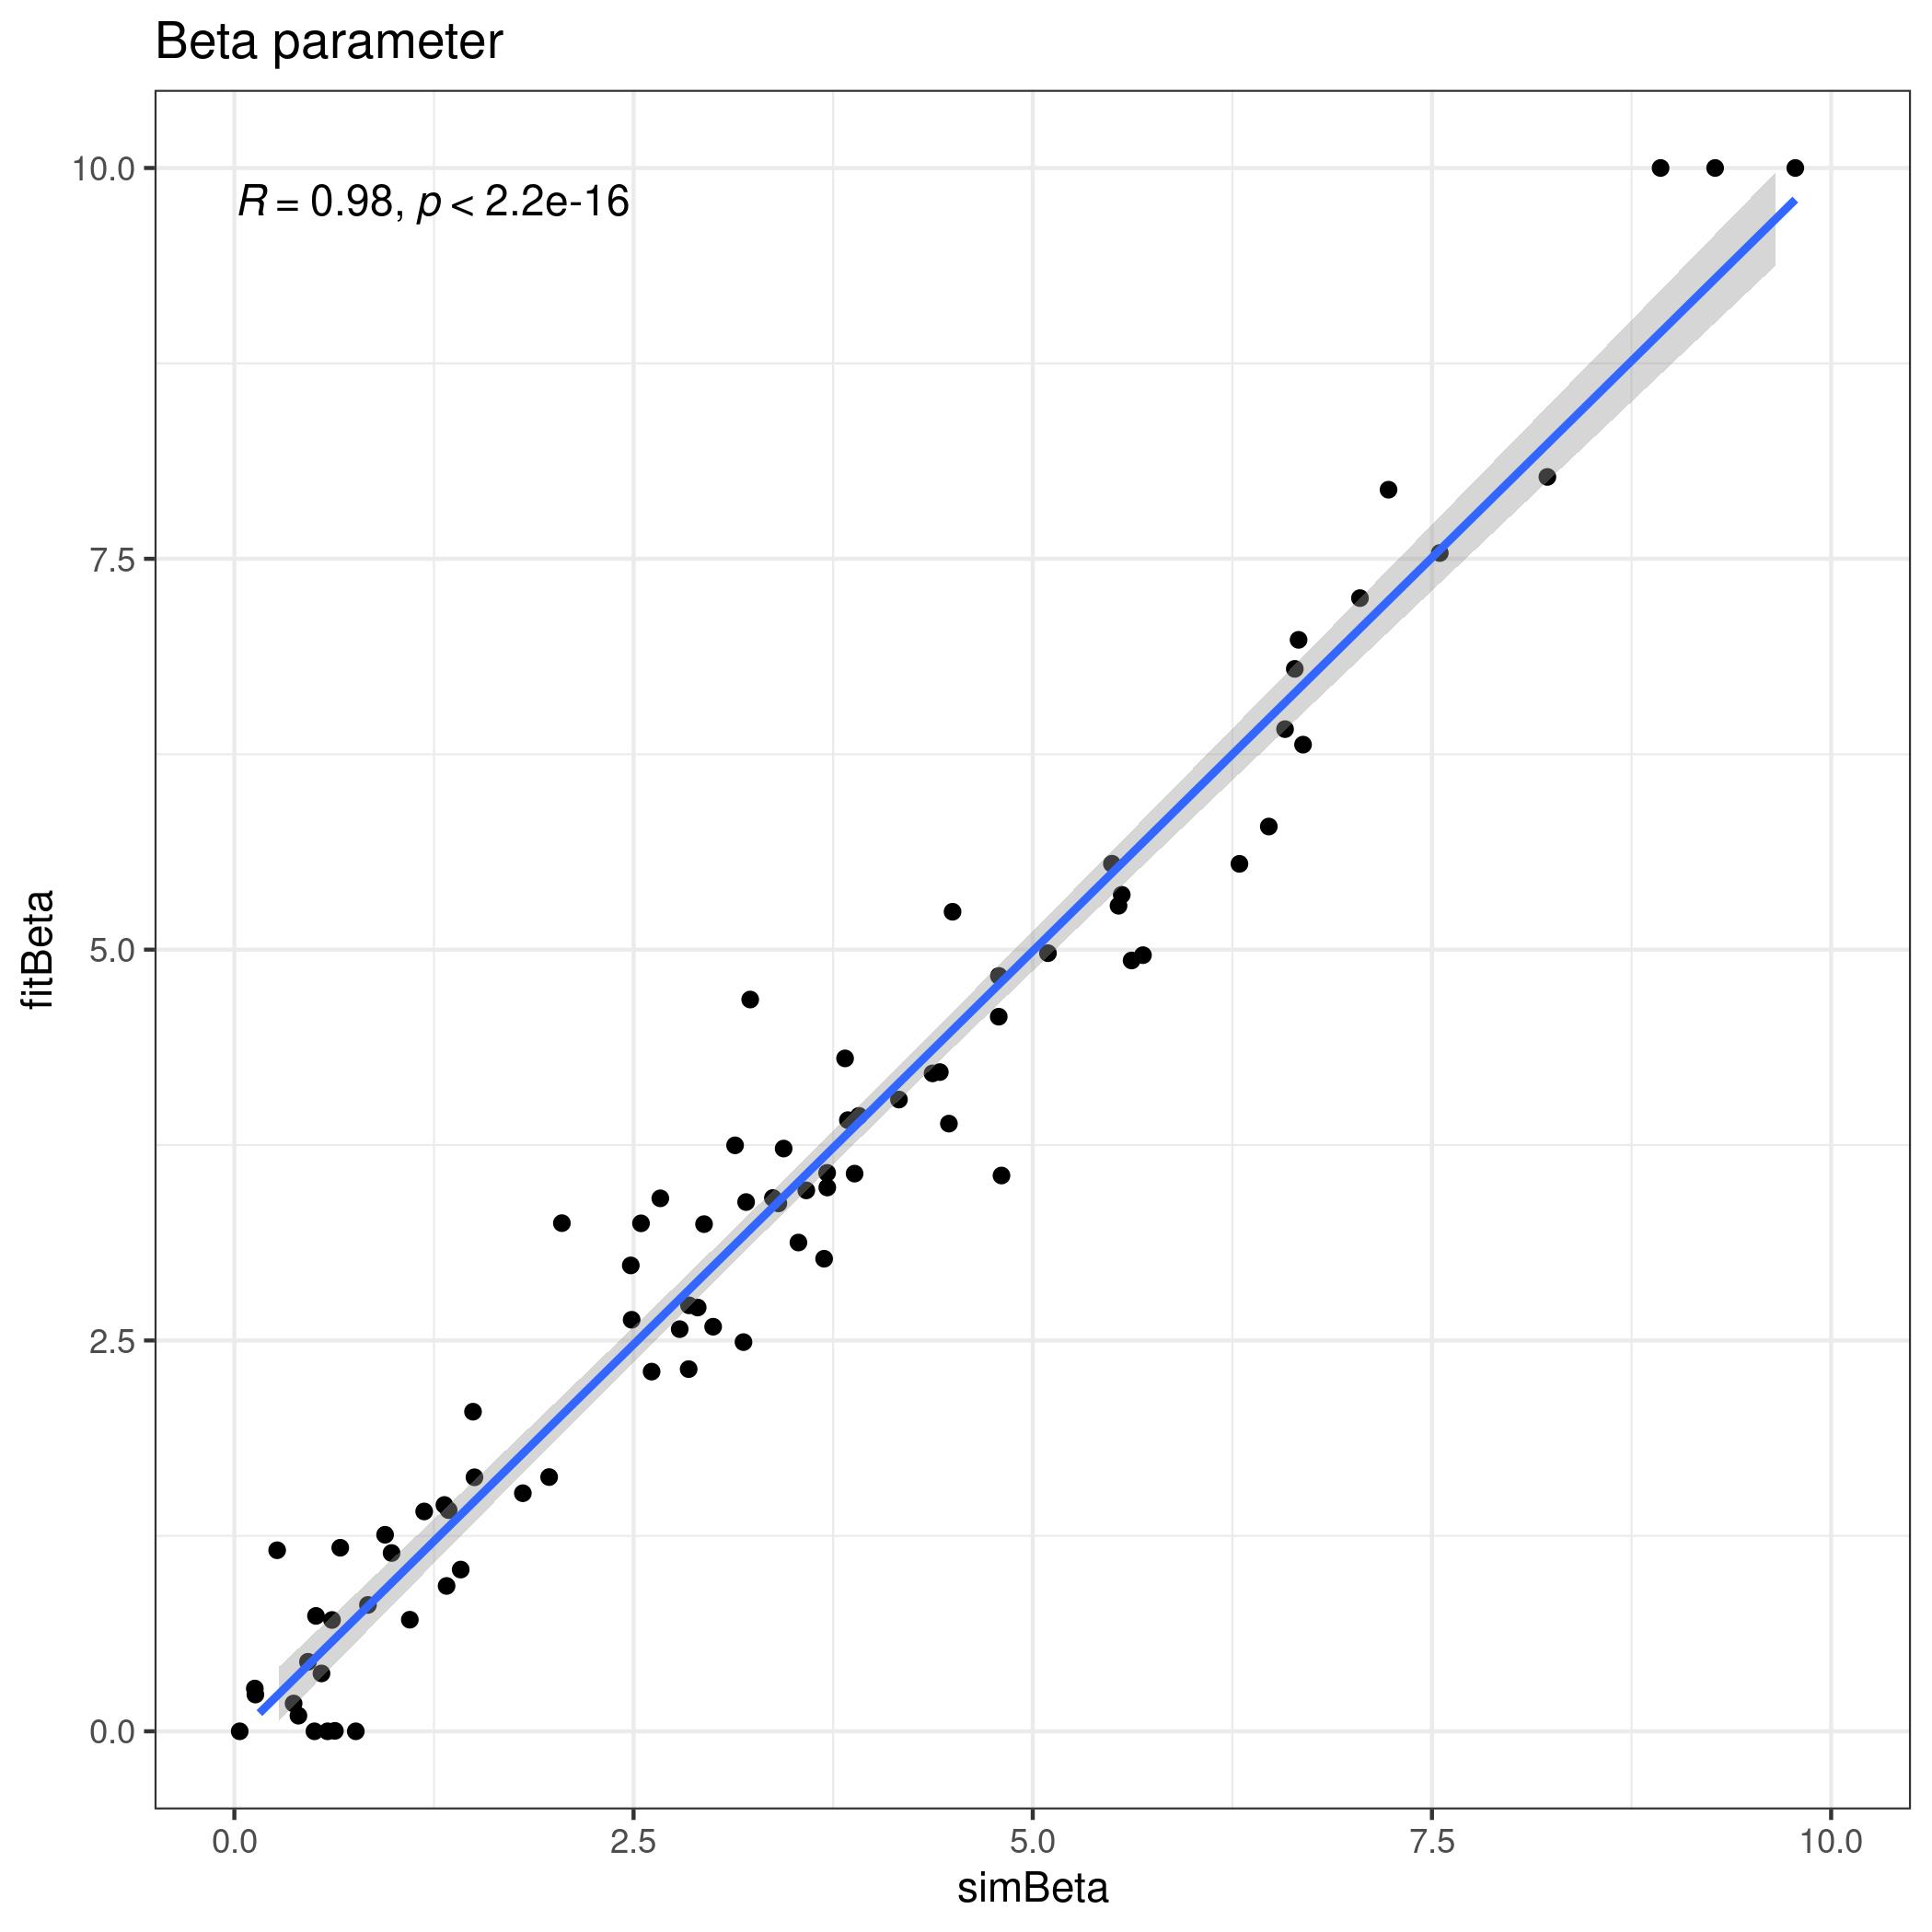
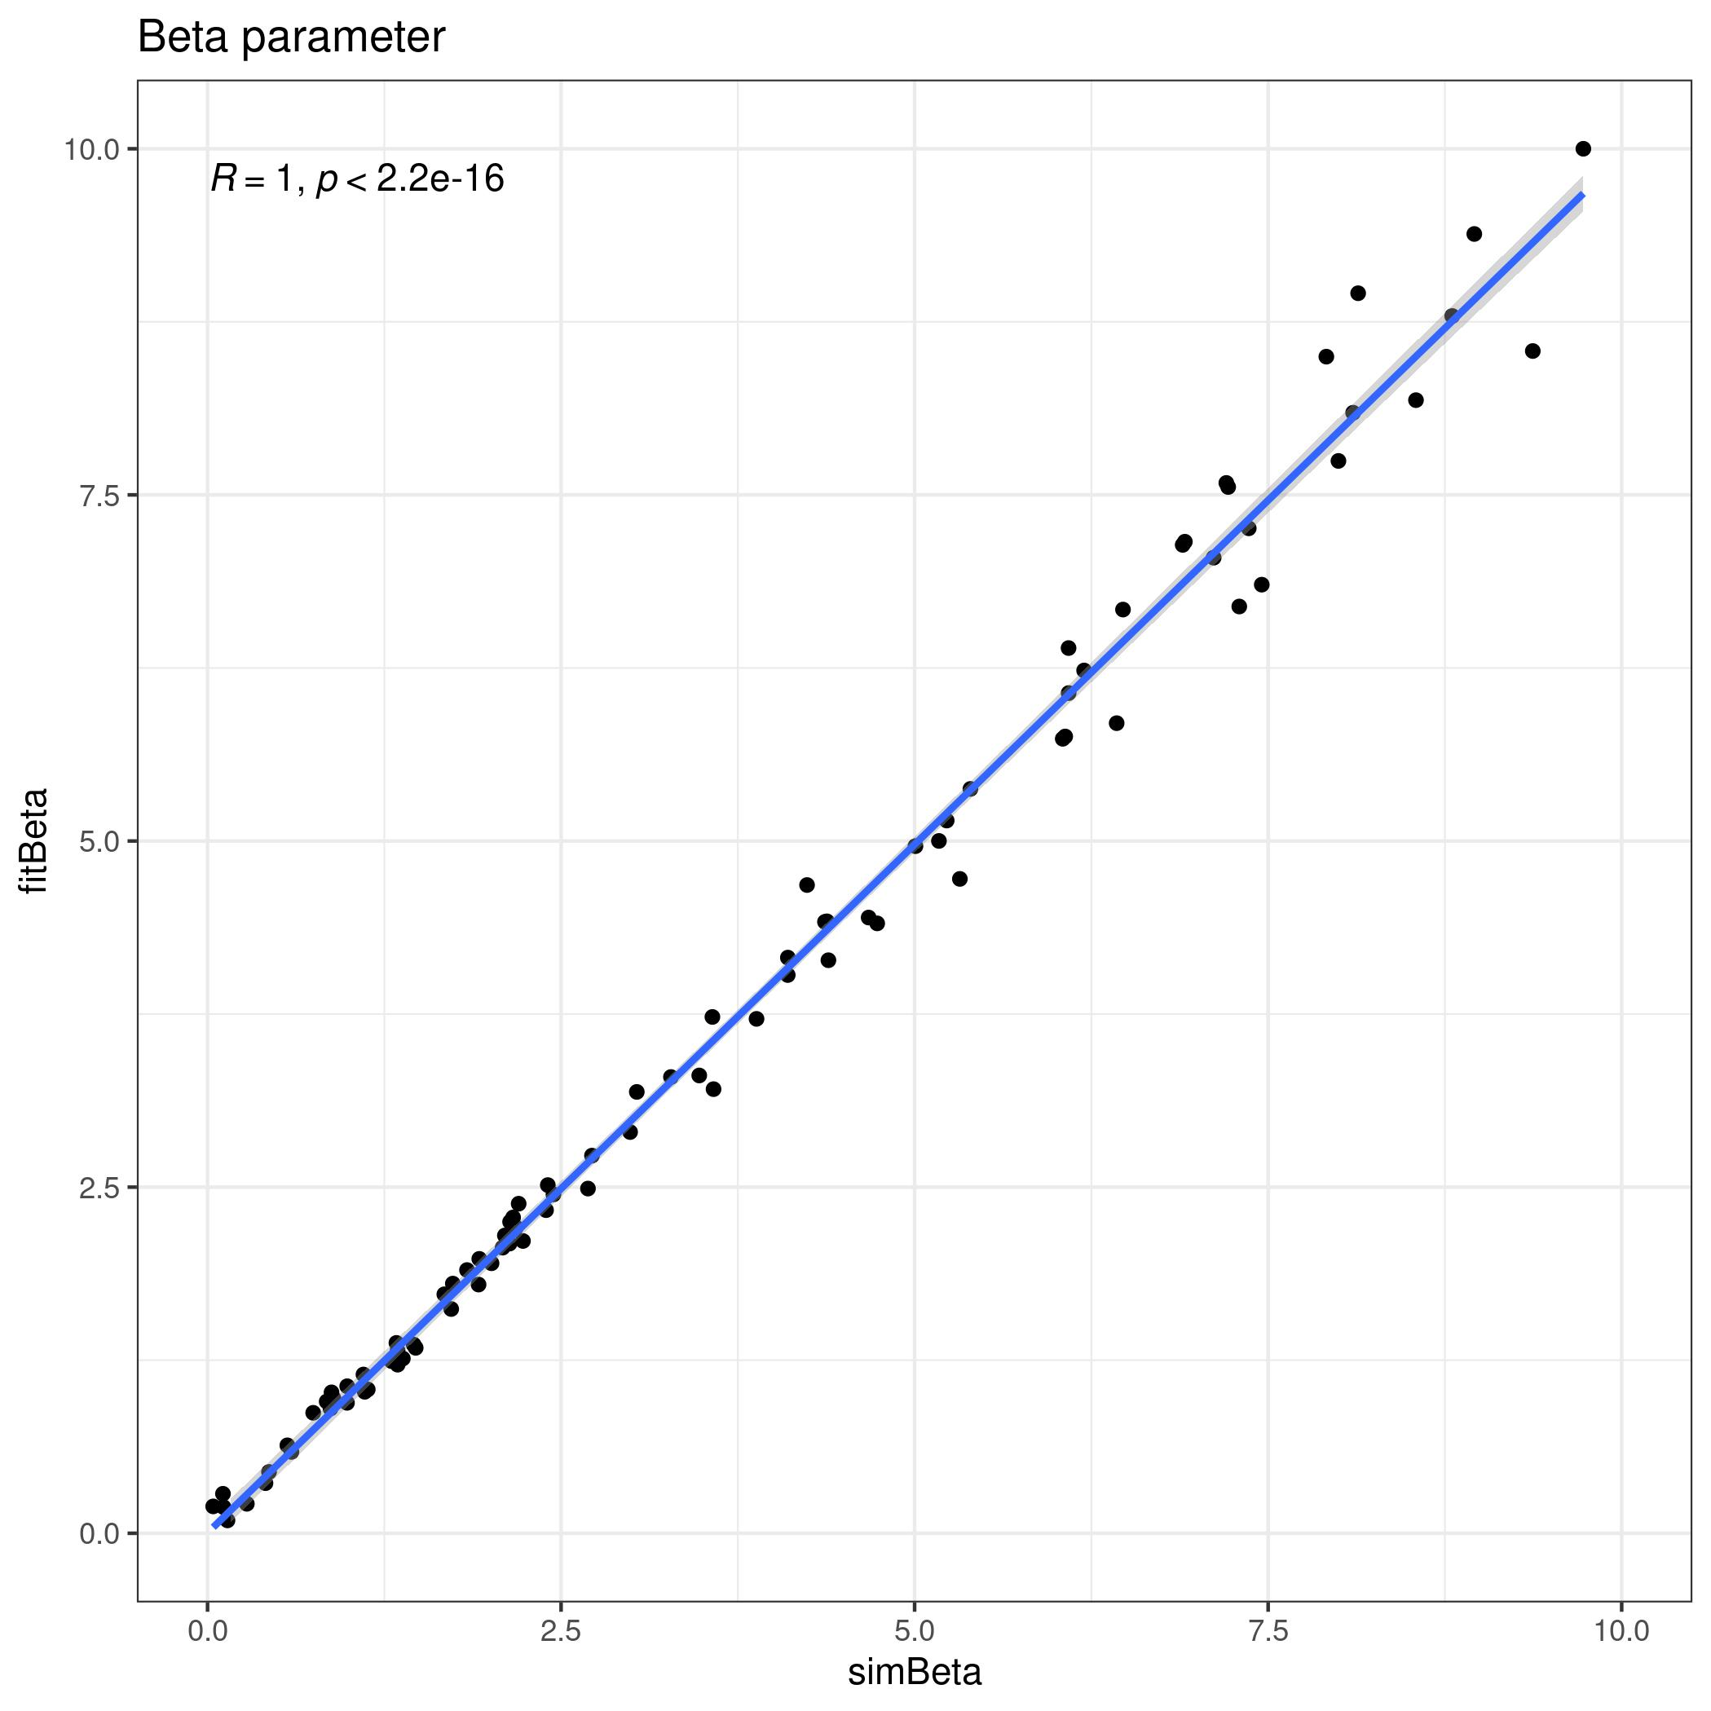
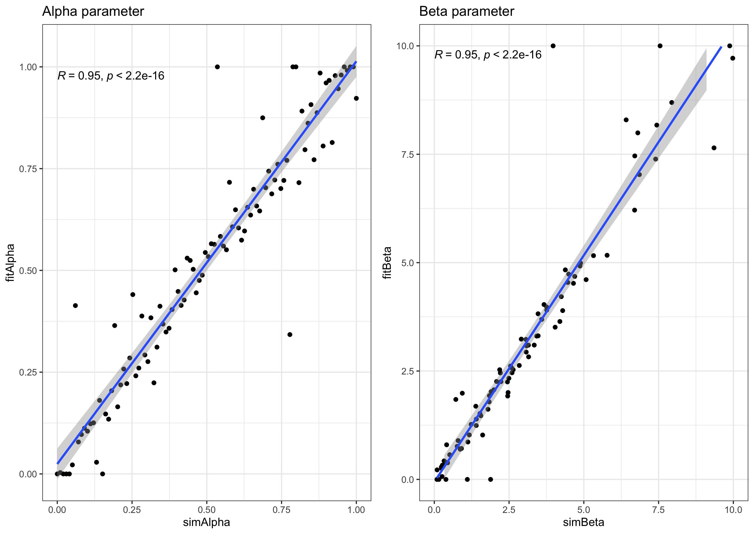
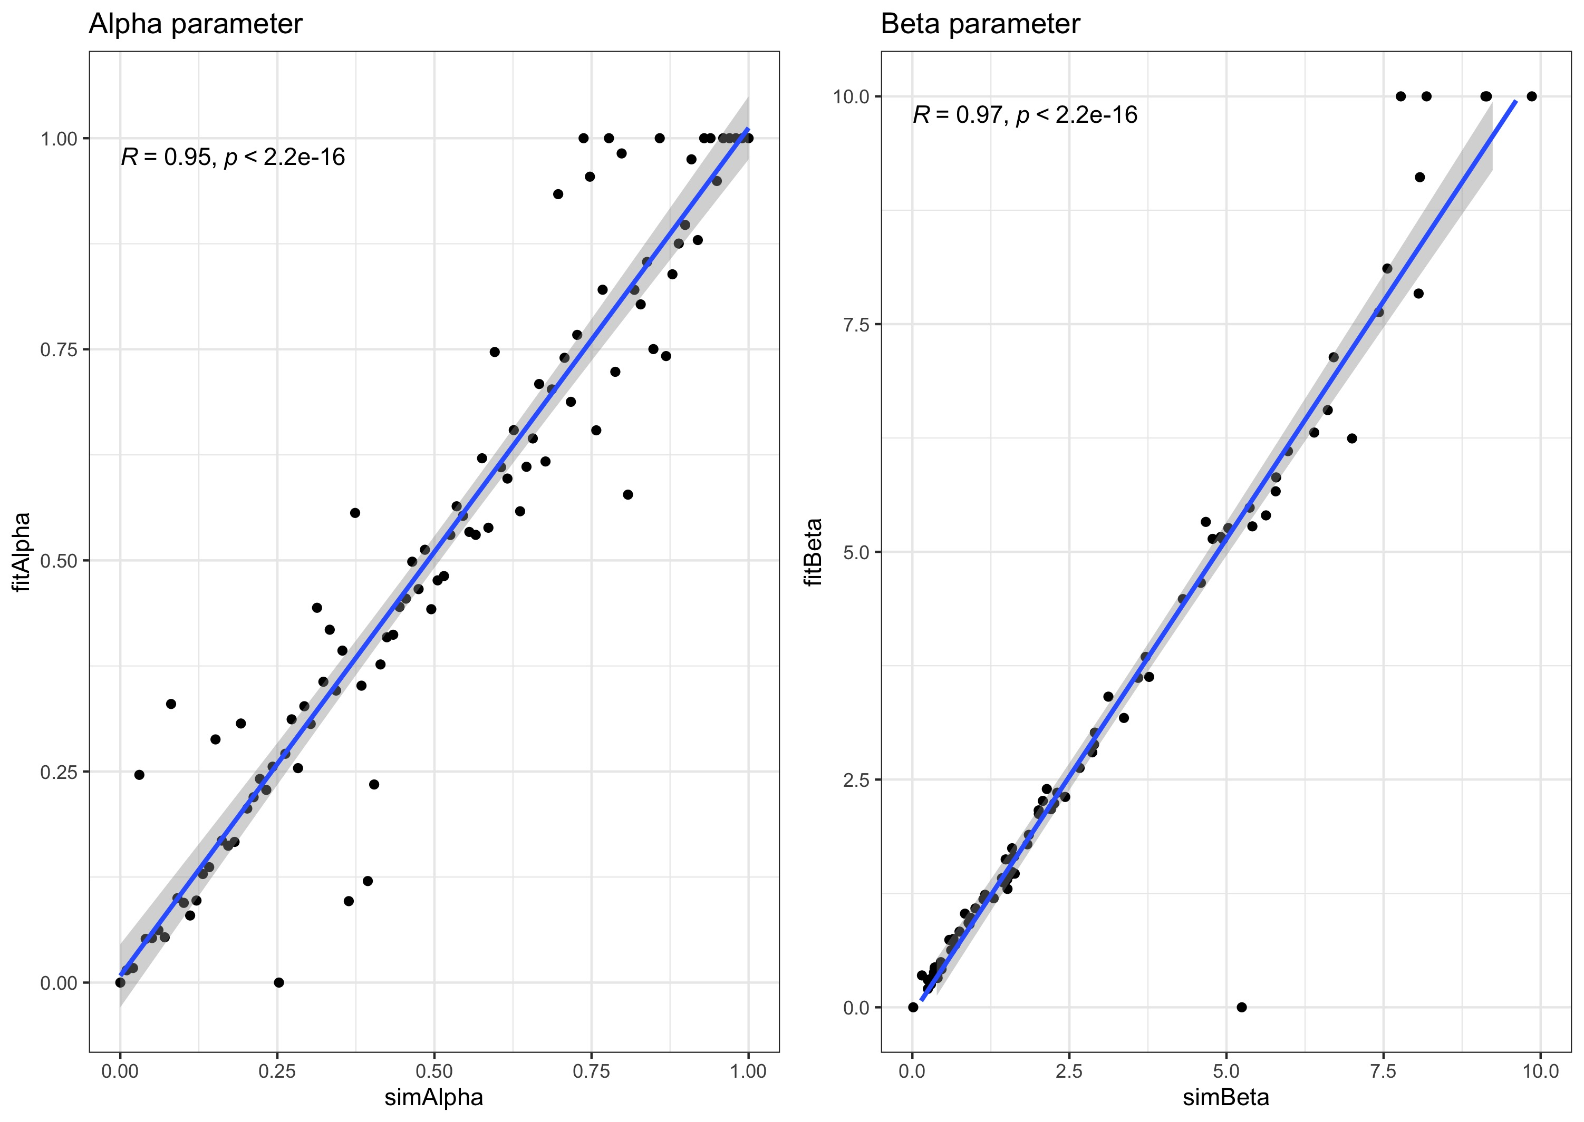
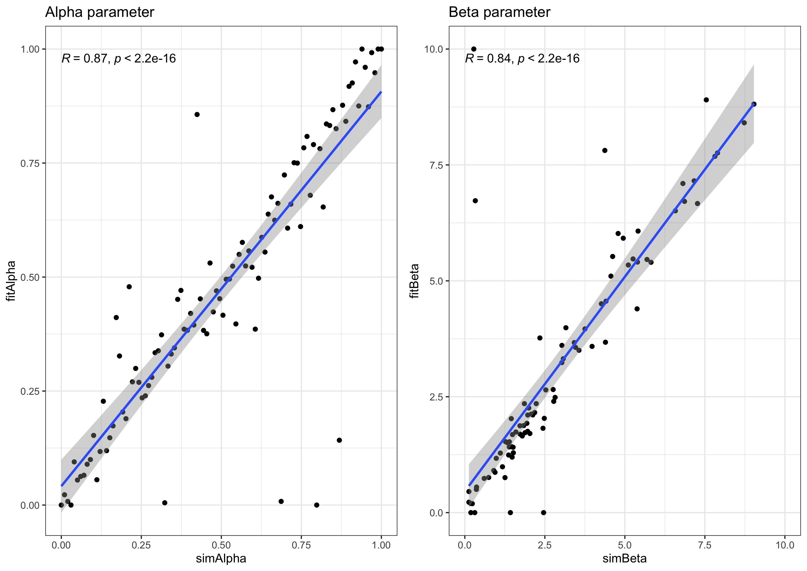
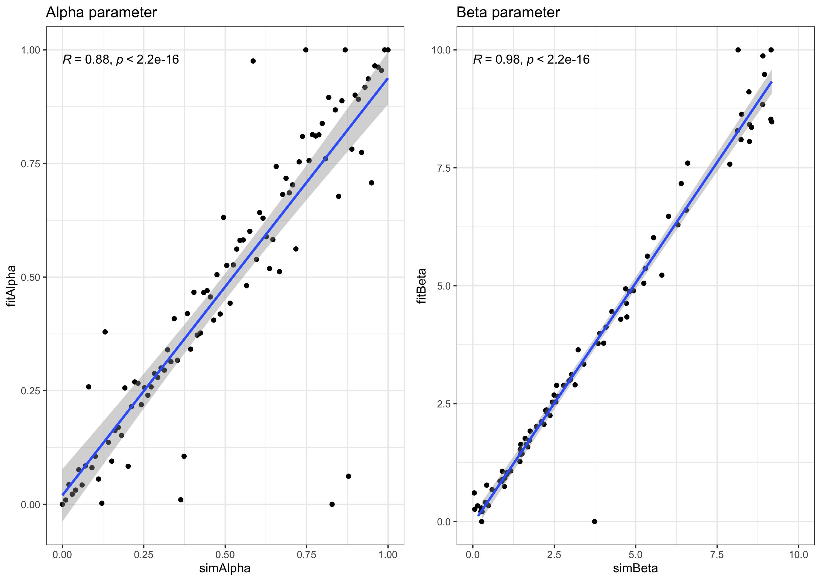
Experiment 1
Experiment 2
Learning Rate
Inverse Temperature
Inverse Temperature
Learning Rate
dLRI
Fitted
fLRI
fLRE
Simulated
Notes:
<number>

Slide 2
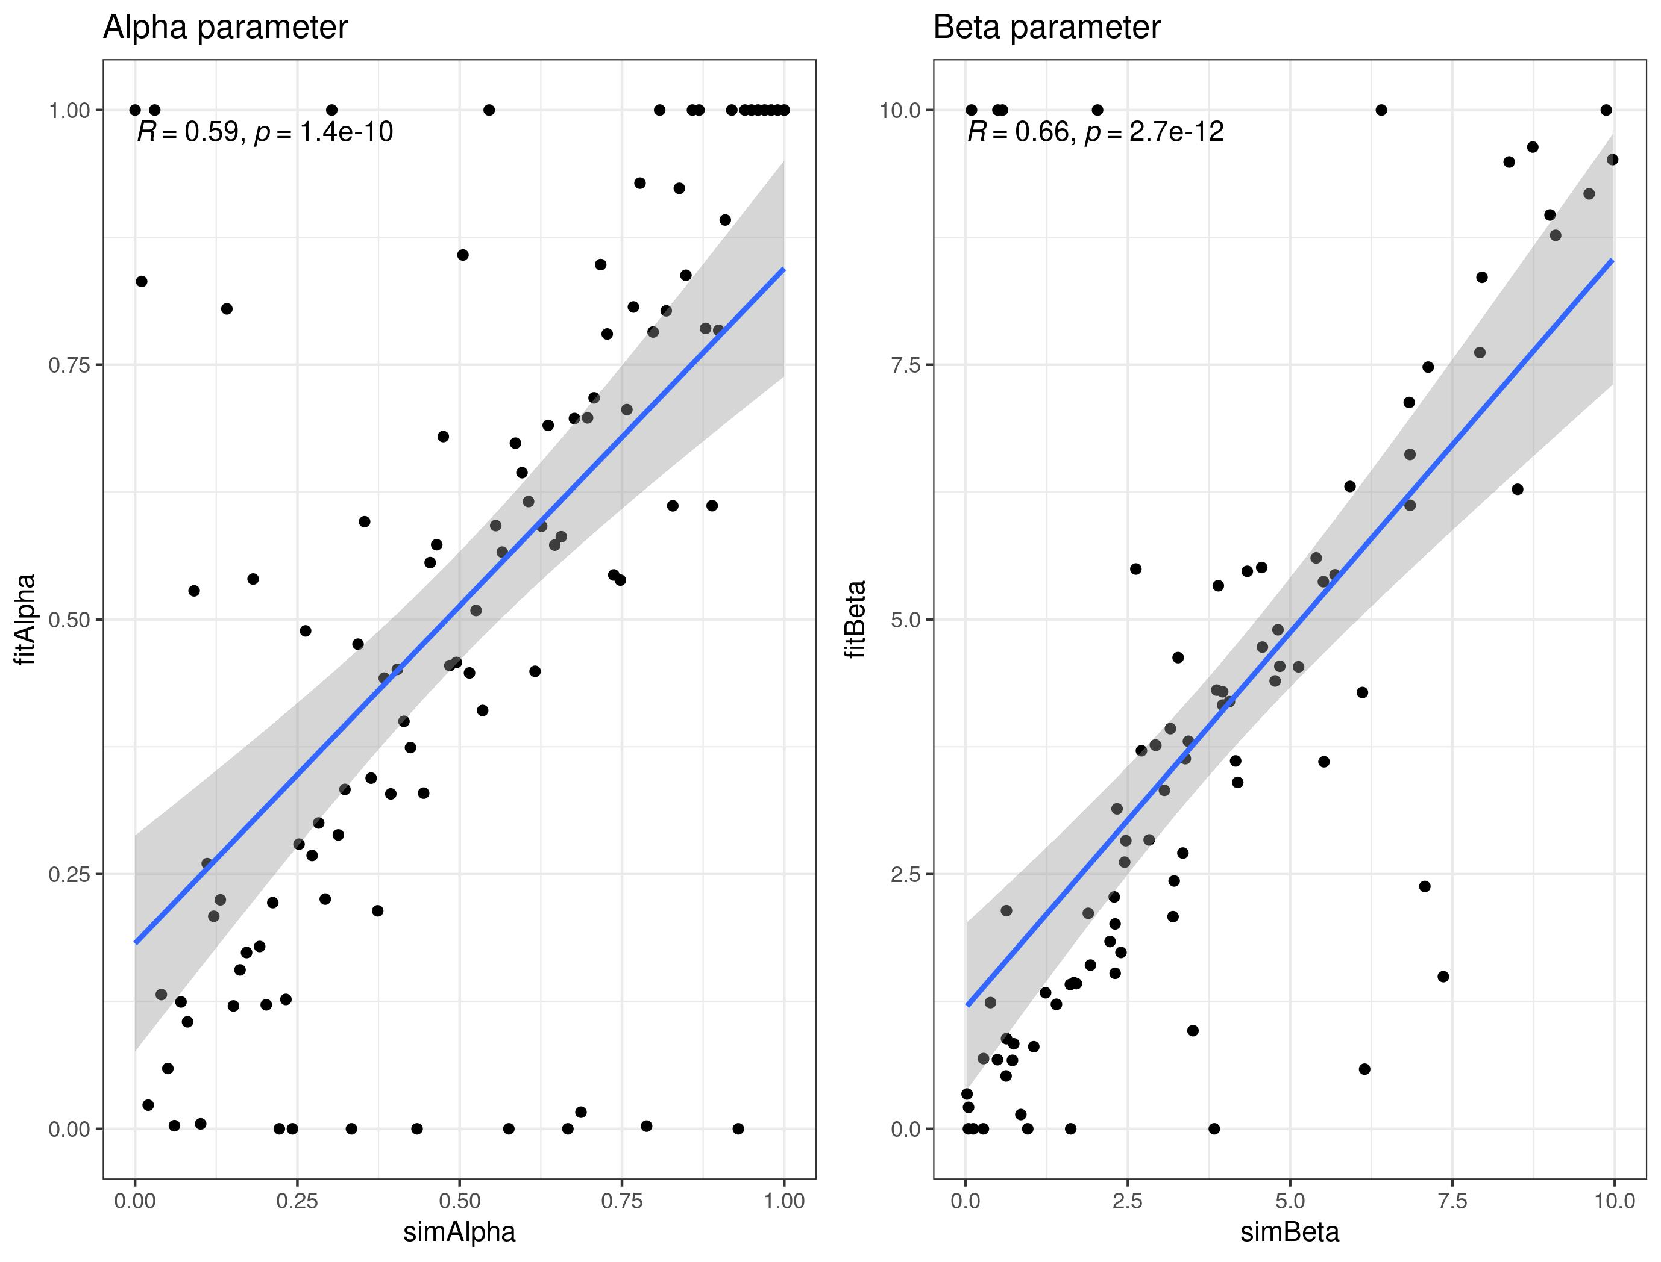
Experiment 1
Simulated
dLRI
dfLRI
fLRI
fLRE
Learning rate
Empirical
Inverse Temperature
Notes:
<number>

Slide 3
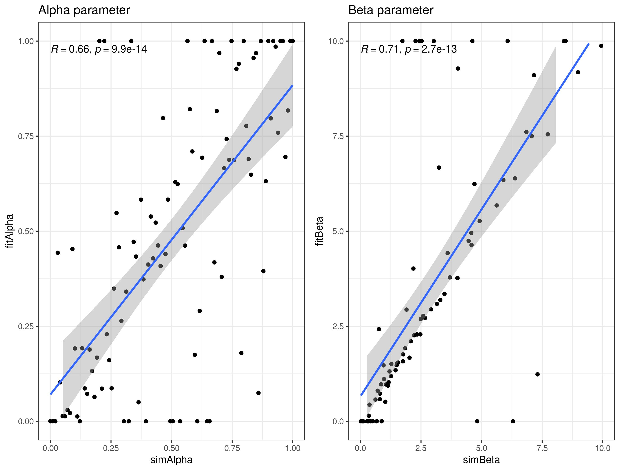
Experiment 2
Simulated
dLRI
dfLRI
fLRI
fLRE
Learning rate
Empirical
Inverse Temperature
Notes:
<number>

